Slide 1

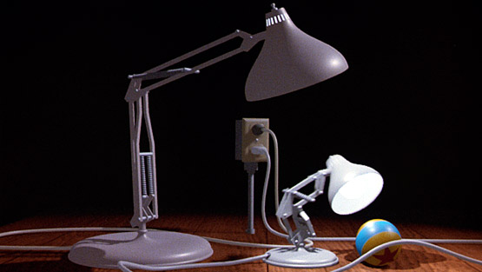
图形变换
Real Time Rendering
步行者
blog.csdn.net/wpxu08
wpxu@outlook.com

Slide 2
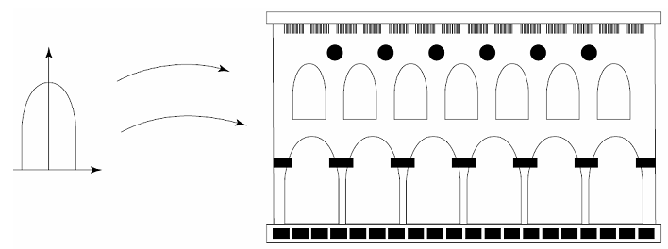
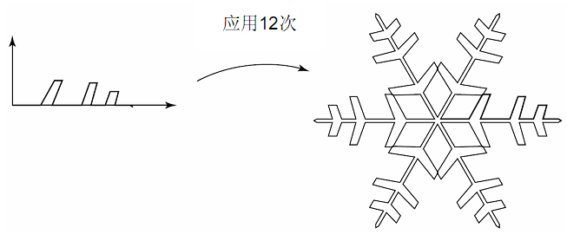
Transforms
With them, you can position, reshape, and animate objects, lights, and cameras
Notes:
利用Maya来引出内容

Slide 3
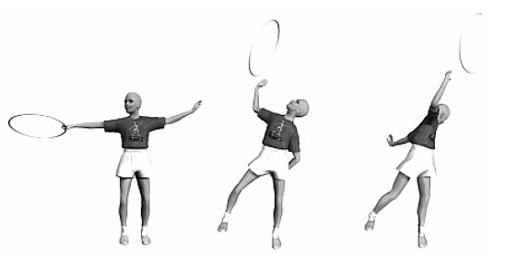
Transforms
With them, you can position, reshape, and animate objects, lights, and cameras
Notes:
利用Maya来引出内容

Slide 4
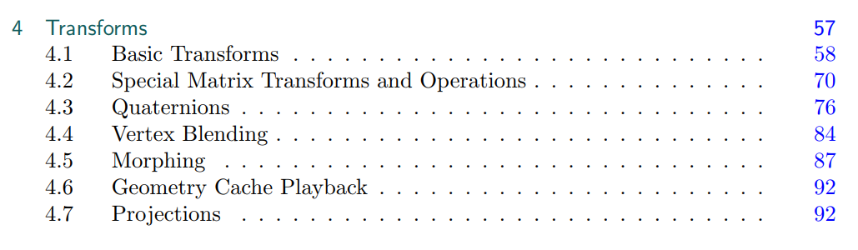
Transforms
With them, you can position, reshape, and animate objects, lights, and cameras

Slide 5
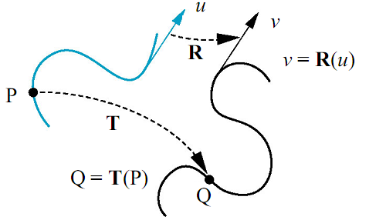
Transforms
变换：把点映射为其它点，把向量映射为其它向量
Notes:
利用Maya来介绍

Slide 6

Basic Transforms
平移
旋转
缩放
错切
变换级联
刚体变换
法线变换
逆矩阵
Notes:
利用Maya来介绍

Slide 7
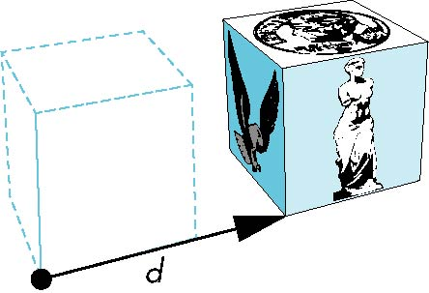

Translation
把一个对象上的所有点沿同一向量平移
对象
平移后的对象

Slide 8
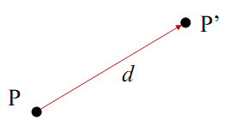
Translation
把一个点移到新的位置
平移由一个向量d确定
三个自由度
P’= P + d

Slide 9
Translation
平移变换:将p点从一个坐标位置移到另一个坐标位置的过程
变换矩阵
新点坐标？

Slide 10
1. 平移变换
Translation

Slide 11
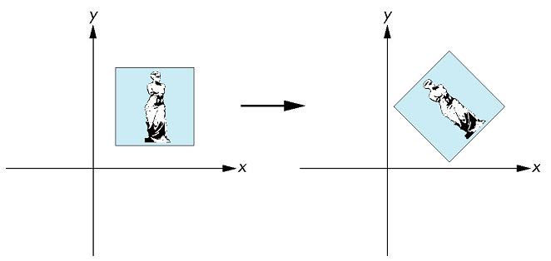
旋转变换

Slide 12
将p点绕坐标原点转动某个角度（逆时针为正，顺时针为负）得到新的点p’的过程
旋转变换

Slide 13
旋转变换
向量表示：

Slide 14
旋转变换
2. 旋转变换

Slide 15
(1)绕z轴旋转
旋转变换

Slide 16
(2)绕x轴旋转
旋转变换

Slide 17
(3)绕y轴旋转
旋转变换
Notes:
Flash演示

Slide 18
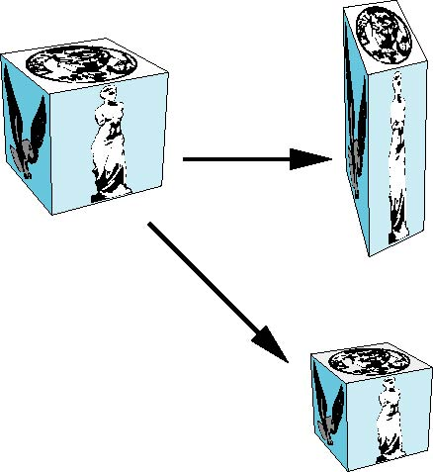
放缩变换
沿每个坐标轴伸展或收缩(原点为不动点）

Slide 19
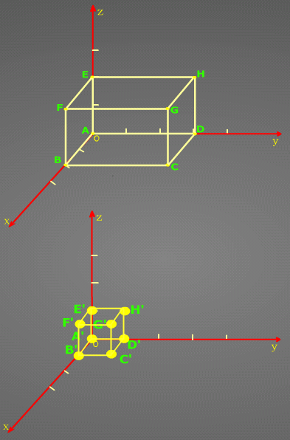
放缩变换
3. 放缩变换

Slide 20
错切变换
用于产生弹性物体的变形处理。在游戏中用它扭曲整个场景,产生虚幻效果.

Slide 21
错切变换
(1)沿x方向错切
每一点的y坐标不变,x坐标平移一个y坐标的线性量.

Slide 22
错切变换
(2)沿y方向错切
每一点的x坐标不变,y坐标平移一个x坐标的线性量.

Slide 23
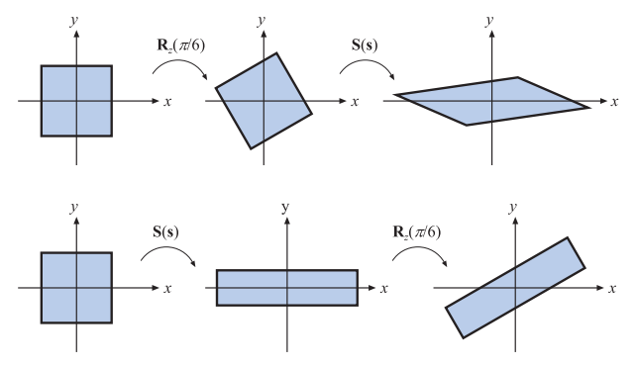
变换级联
Due to the noncommutativity of the multiplication operation on matrices, the order in which the matrices occur matters
Concatenation of transforms is therefore said to be order-dependent

Slide 24
变换级联
The obvious reason to concatenate a sequence of matrices into a single one is to gain efficiency
C = TRS
Instead of multiplying all vertices with each of the three matrices, the three matrices are concatenated into a single matrix

Slide 25
The Rigid-Body Transform
the object’s orientation and location change, while the shape of the object generally is not affected
Such a transform, consisting of concatenations of only translations and rotations, is called a rigid-body transform
It has the characteristic of preserving lengths, angles, and handedness

Slide 26
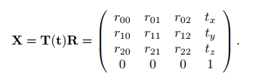
The Rigid-Body Transform
Any rigid-body matrix, X, can be written as the concatenation of a translation matrix, T(t), and a rotation matrix, R
X has the appearance of the matrix in Equation

Slide 27
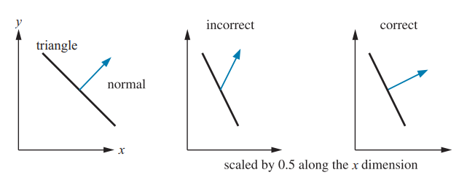
Normal Transform
A single matrix can be used to consistently transform points, lines, triangles, and other geometry
The same matrix can also transform tangent vectors following along these lines or on the surfaces of triangles

Slide 28
Normal Transform
However, this matrix cannot always be used to transform one important geometric property, the surface normal (and the vertex lighting normal)
Figure 4.6 shows what can happen if this same matrix is used

Slide 29
Normal Transform
Instead of multiplying by the matrix itself, the proper method is to use the transpose of the matrix’s adjoint
The traditional answer for transforming the normal is that the transpose of the inverse is computed
This method normally works
The full inverse is not necessary, however, and occasionally cannot be created

Slide 30
Computation of Inverses
Inverses are needed in many cases, for example, when changing back and forth between coordinate systems.
Depending on the available information about a transform, one of the following three methods of computing the inverse of a matrix can be used

Slide 31
Computation of Inverses
If the matrix is a single transform or a sequence of simple transforms with given parameters, then the matrix can be computed easily by inverting the parameters and the matrix order
For example, if M = T(t)R(φ), then
M⁻¹ =R(-φ)T(-t)

Slide 32
Computation of Inverses
If the matrix is known to be orthogonal, then M⁻¹ = M^{T} , i.e., the transpose is the inverse
Any sequence of rotations is a rotation, and so is orthogonal

Slide 33
Computation of Inverses
If nothing is known, then the adjoint method, Cramer’s rule, LU decomposition, or Gaussian elimination could be used to compute the inverse
Cramer’s rule and the adjoint method are generally preferable, as they have fewer branch operations
“if" tests are good to avoid on modern architectures
Notes:
避免if测试

Slide 34
Basic Transforms
平移
旋转
缩放
错切
变换级联
刚体变换
法线变换
逆矩阵
Notes:
利用Maya来介绍

